Slide 1
Tier 1 Team Training
Day 3
Feedback & Acknowledgement
(TFI 1.9)
Updated April 2022
Notes:
This presentation will prepare teams for success in implementing Positive Feedback.
Updated 7/2018

Slide 2
Learning Expectations
EXPECTATION | BEHAVIOR
Be Responsible | Make yourself comfortable Take care of your needs (water, food, restroom, etc.) Action plan to implement what you are learning Follow through on your action items
Be Respectful | Turn cell phones off or to “vibrate” Listen attentively while others are speaking Have only the training materials up on your computer/tablet/phone
Be Engaged | Ask what you need to know to understand and contribute Contribute to the group by sharing relevant information and ideas
Notes:
2
Have teams review training expectations

Slide 3
Tier 1: Implementation Fidelity
TFI Sub-Scale: Team
TFI 1.1 | Team Composition
TFI 1.2 | Team Operating Procedures
TFI Sub-Scale: Evaluation
TFI 1.12 | Discipline Data
TFI 1.13 | Data-based Decision Making
TFI 1.14 | Fidelity Data
TFI 1.15 | Annual Evaluation
TFI Sub-Scale: Implementation
TFI 1.3 | Behavioral Expectations
TFI 1.4 | Teaching Expectations
TFI 1.5 | Problem Behavior Definitions
TFI 1.6 | Discipline Policies
TFI 1.7 | Professional Development
TFI 1.8 | Classroom Procedures
TFI 1.9 | Feedback and Acknowledgement
TFI 1.10 | Faculty Involvement
TFI 1.11 | Student/Family/Community Involvement
Notes:
3
Orient team to the content on our implementation roadmap

Slide 4
TFI 1.9 Purpose & Outcome
Purpose:
Teams will develop a formal system for providing specific behavior feedback that is linked to school-wide expectations and used within classrooms and across school campus settings.
Outcome:
A formal system (a written set of procedures) for acknowledging student behavior exists and is used by staff.
Notes:
Read through the purpose and outcome emphasizing that teams will develop a formal system for implementing feedback & acknowledgement.

Slide 5
Culturally Responsive Elaboration
SWPBIS Big Idea
Attending to and acknowledging desired student behaviors increases the likelihood of these behaviors recurring and promotes a positive school culture.
Feedback and Acknowledgement Focuses On…
Teams involve students, families, and communities in the development and use of acknowledgement systems in order to create systems that are meaningful and authentic.
School teams consider the culture of the students they serve when designing recognition systems (e.g., opportunity to share success with friends).
In addition, teams and school staff understand that learning a new skill requires additional reinforcement, particularly when habits are already formed (e.g., behaviors are valued and/or meet a functional need outside of the school setting).
Notes:
Provide teams with the overall goal of implementing Feedback and acknowledgement.

Slide 6
How can we make Positive Feedback more culturally responsive?
Teams actively seek feedback from students, families, and the community about preferences for acknowledgement and perceptions of the current systems at least annually.
Teams actively seek connections within the community for the acknowledgement system to be reinforced (e.g., use of reinforcements in community settings such as restaurants).
Teams assess racial/ethnic equity in acknowledgement systems (i.e., rewards used consistently with all groups of students) with valid tools (e.g., TFI Walkthrough Tool, Stakeholder Input and Satisfaction Survey) multiple times throughout the school year.
For students who have received multiple referrals, teams audit the frequency of use of acknowledgement and feedback in the re-teaching process.
Page 21
Notes:
The main idea of this slide is to get teams thinking about how to make feedback and acknowledgment more equitable for all stakeholders.

Slide 7
Feedback & Acknowledgement Tasks
Develop Acknowledgement Matrix
Develop concrete symbol (Gotcha)
Plan PD on strategies for Providing Feedback and Acknowledgement
Communicate plan to gain feedback from staff
Notes:
This slide let’s teams know the implementation actions they will take to develop a feedback & acknowledgement system with fidelity so they can achieve the outcomes just outlined.

Slide 8
Why is providing positive feedback so important?
Positive feedback is the presentation of something pleasant or rewarding immediately following a behavior.
It makes that behavior more likely to occur in the future, and is one of the most powerful tools for shaping or changing behavior.
(SBCUSD Positive Behavior Support Initiative)
Notes:
Behavior Basic slide. Everyone needs to be on the same page about why providing positive feedback is important to creating the environment for learning.

Slide 9
SO MUCH RESEARCH TO BACK THIS PRACTICE UP!
Reinforce the teaching of new behaviors
Strengthen and encourage the behaviors we want to occur again in the future
Every adult interaction with a student is an instructional moment that influences what happens next.
Research indicates that you
can improve behavior
by 80% just by pointing out
what someone is doing
correctly.
Laura Riffel, OSEP
Notes:
Use of acknowledgements to reinforce behavior is research based. Being intentional with what we reinforce is hard work, but will be beneficial.

Slide 10
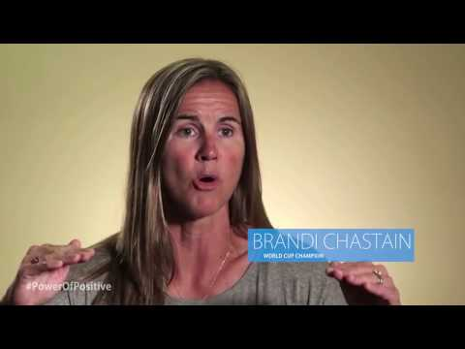
Research Recommendations for Providing Positive Feedback
Recognize both effort and mastery
Make recognition specific and aligned with expected performance and behavior
More recognition than correction occurs
Pair recognition with a concrete symbol
How does this apply to the school setting?
Notes:
Give teams 3 minutes to talk about role of recognition in building a positive community where students are willing to fail, take risks and feel seen and valued for their worth as an individual who is learning and growing.

Slide 11
Recognition is Aligned and Specific
Train All Staff on Providing Behavior Specific Praise
Steps for Providing Behavior Specific Praise (BSP)
Step 1: Use the student’s name
Step 2: Name the behavior observed
Step 3: Tie back to school-wide expectations
Example: Jay, nice job sitting in your seat when the bell rang. Way to be there, and be ready.
Non-example:
Giving ticket without saying anything
Giving ticket for non-school wide expectations
Only giving for “above and beyond” behavior
Saying just, “Nice job,” “Good,” or “Fantastic.”
Notes:
Behavior Specific Praise is an evidence-based practice. This slide outlines the steps for implementing Behavior Specific Praise. These steps must be followed for the outcome to be achieved. All staff should be trained and provided with practice opportunities so that this becomes an automatic way of providing positive feedback.

Slide 12
Choose an example and practice
Quick Think and Write
Choose one example below and think about how you can provide aligned and specific recognition-Behavior Specific Praise
Student is on time for class
Student is helping clean up in the cafeteria
Student follows the morning routine
Student is walking in the hallway
Include: student name • what you saw • how that aligns to your expectations
Partner Talk and Share your examples
Notes:
Have teams practice in pairs

Slide 13
Positive Feedback Occurs more Frequently than Correction
Correction
Effort & Mastery
(reinforcement)
5:1
Notes:
Studies show that in order to be successful the positives need to exceed the negatives by a ratio of more than 4 to 1 (family & marriage therapy research). Tier 1 PBIS recommendation is 5:1.

Slide 14
How does 5:1 happen?
All Staff are expected to:
Interact in a friendly, supportive manner at all times---students, parents, guests and colleagues
Initiate positive interactions by:
Making eye contact
Welcoming
Offering a greeting
Asking if assistance is required
Providing positive feedback regarding appropriate student behavior
Maintaining an attitude of respect and support, even when correcting student behavior
Notes:
Certainly we are in the business of creating a welcoming environment for all stakeholders. The expectations that all staff will do the things listed on this slide is a minimal one.

Slide 15
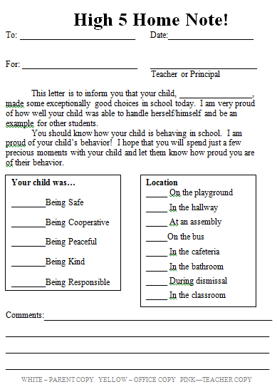
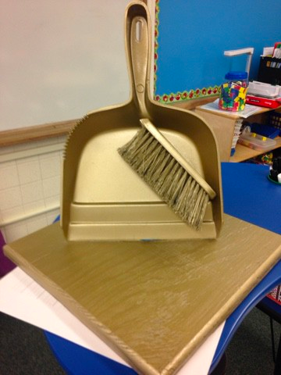
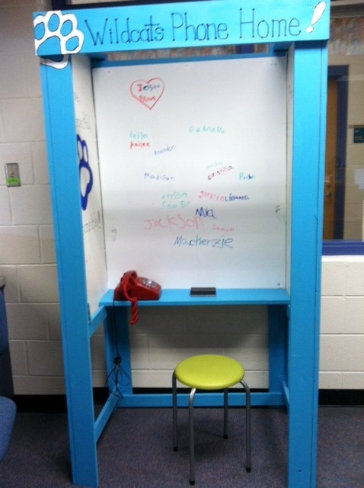
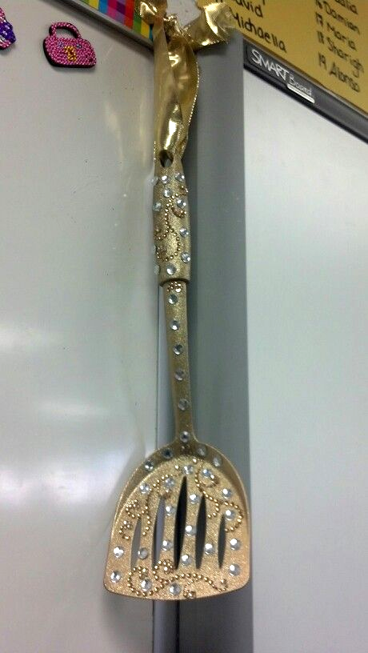
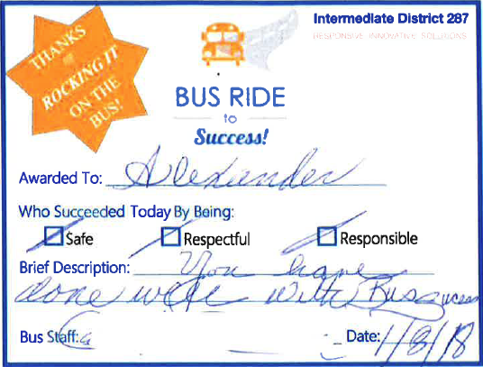
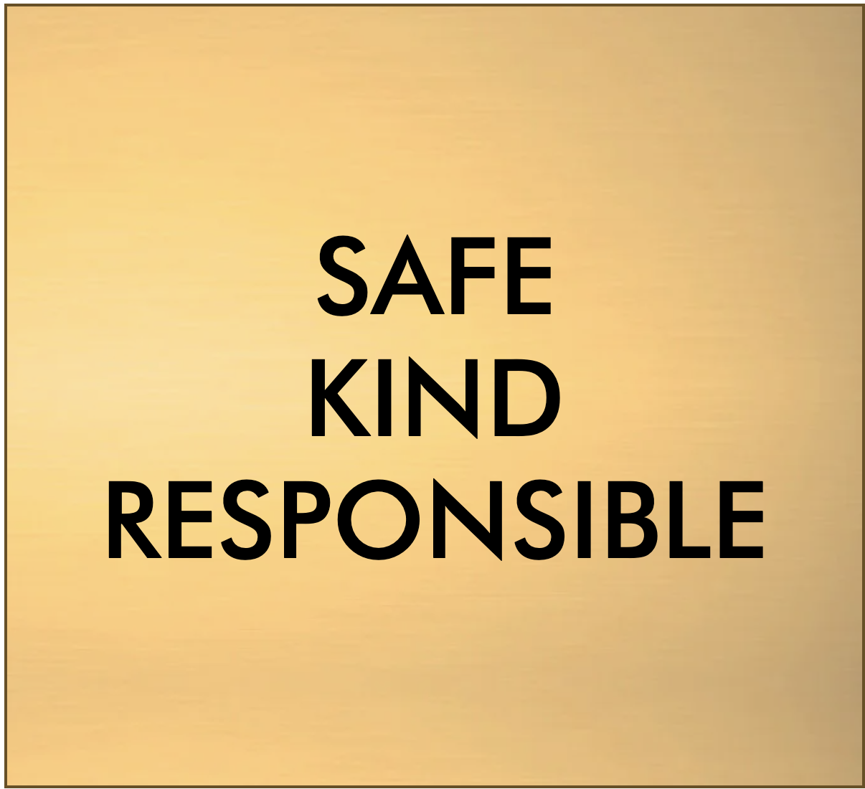
Pair Positive Feedback with a Concrete Symbol
Administrative Staff
Building Maintenance Staff
Individual High Frequency
Golden Awards Help All Staff Participate in Positive Intermediate Recognition
School to Families
Food Service Staff
Playground Supervising Staff
Bus Drivers
Notes:
Emphasize that the FEEDBACK is the most important piece, not the “thing” that you are handing out, but if the thing received has meaning for the receiver it can strengthen the feedback.

Slide 16
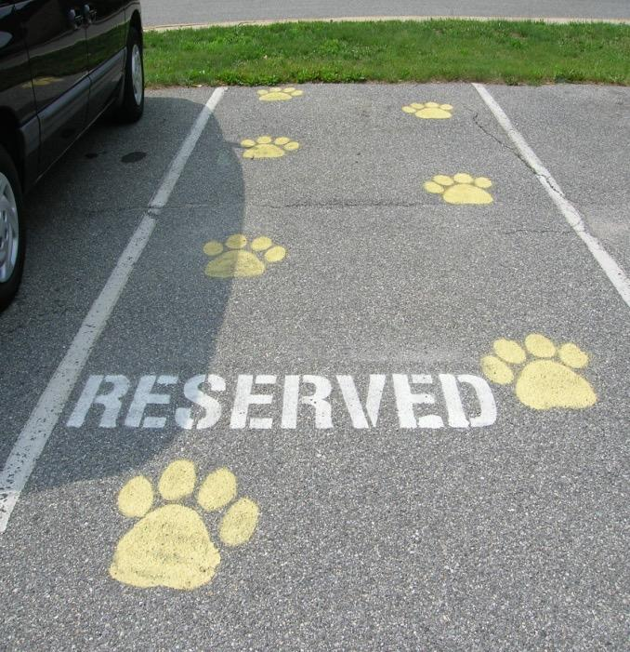
Keep Staff Motivated and Appreciated!
Restaurant coupons for staff who gave winning student coupon
Auto detailing for staff member
Starbucks delivered to class
Reserved Parking Spot (parking closest to school)
“Whale Done” Trophy - The principal presents it to the first winner at the first faculty meeting, modeling how it was to be presented. After that each winner looks for a colleague to whom the trophy can be given the next time
Extra planning period coupon
Thank you cards to teachers for support
Celebrate Together-Bring Food
PBIS Tier 1 Team to Staff
Notes:
PBIS implementation will require staff to learn new systems and new skills. Just like students, at a minimum they need positive feedback for their willingness to implement new systems and strategies, and that feedback may be strengthened by meaningful things.

Slide 17
Concrete symbols can strengthen your feedback,
but remember…
What really matters is the positive interaction, to connection. Positive Connections on the outside build neural connections on the inside.
Notes:
Every interaction we have with a student matters. Every interaction is an opportunity to build relationship and trust and builds a positive learning environment where staff and students thrive.

Slide 18
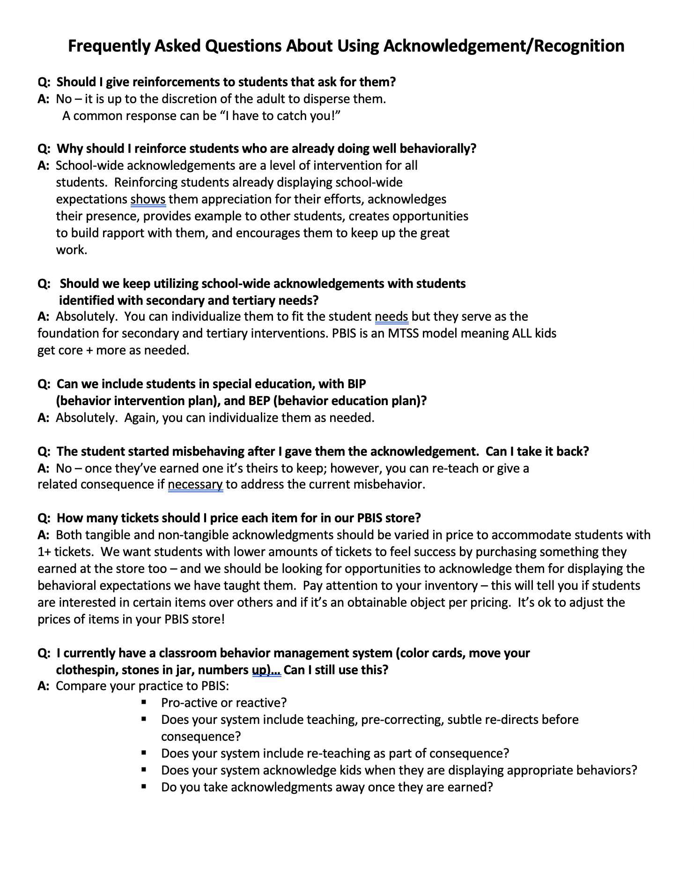
Team Implementation Planning
Quick Read and Think
Read through the Frequently Asked Questions Handout.
What thoughts or questions did you have as you read?
Table Talk and Share your thoughts/questions.
Talk with your team about it.
Frequently Asked Questions about Recognition
Notes:
Have teams read through the frequently asked questions handout. Give them time to talk about thoughts/questions that came up as they read. (10 minutes)

Slide 19
Guidelines for School wide Recognition
Recognition is about providing positive feedback for EVERY student!
Recognize the behavior & connect to SW expectation
Recognition closely follows the desired behavior
Include the students in identifying deliver of recognition
Create a system that is easy to implement consistently across the school campus
Create a communication plan
Notes:
These guidelines will help the team think about all that goes into developing a SW system for providing positive feedback

Slide 20
Feedback & Acknowledgement System Checklist
We have a system of recognition that is being implemented consistently across campus for students and staff
We use a variety of methods to recognition student effort and mastery
Staff provide immediate and specific recognition
Our concrete symbols are linked to our expectations and goals
Our concrete symbols are varied to maintain student interest
The ratio of recognition to correction is high
Students are involved in identifying/developing incentives
Notes:
This checklist will help teams develop an acknowledgment system.

Slide 21
This Tool will help you plan
Acknowledgement Matrix
TYPE | WHAT | WHEN | WHERE | WHO
Immediate/High Frequency In the moment, predictable, delivered at a high rate for a short period (e.g., Gotchas, Paws, High Fives) | STUDENTS: ADULTS: | High frequency for a short time when first teaching desired behavior or re-teaching identified problem behavior from data |  | ALL STUDENTS, ALL ADULTS
Redemption of high frequency (e.g., school store, drawings) | STUDENTS: ADULTS: | At least monthly |  | ALL STUDENTS, ALL ADULTS
Intermittent/Unpredictable (e.g., surprise homework completion treat, random use of gotchas in hallway) | STUDENTS: ADULTS: | Maintaining a taught behavior (fading) |  | ALL STUDENTS, ALL ADULTS
Long-term School-wide Celebrations (school-wide not individually based) FOR: Ex: ODR reduction, school-wide target met for certain setting/behavior area ACTIVITY: (e.g., ice cream social, dance, game day) | BOTH TOGETHER: | At least quarterly |  | ALL STUDENTS, ALL ADULTS
Notes:
Emphasize 3 different types/ 3 different purposes and when to use
Long term celebrations are for ALL students….referral free parties DO NOT count!!!!!
Information from George Sugai:
The discussion was about long-term celebrations that all kids attend vs. long term celebrations that have criteria (0-1 referrals for a semester) for attendance.
1. Contingencies that link reinforcer to whole group behavior performance (e.g., If more than 80% of students have perfect attendance, whole school gets special assembly).
2. For kids with challenges, I like having separate individualized criteria and reinforcers (e.g., If Steve attends school 70% of days, he can also sit with friends of his choice).
3. Students with 100% can get some additional acknowledgement beyond what whole group get.
Etc.
The general big idea is that all kids get what the collective earns. Some kids (100% AND specialized needs kids) get extra for exceptional performance

Slide 22
Team Implementation Planning
Use TFI 1.9 Teaching Expectations Activities to guide your work.
Implementation Planning Workbook: TFI 1.9 Feedback & Acknowledgement Activities 1-3
Professional Development
How and when will you bring this information back to staff?
Update your action plan as needed for
1.9
Notes:
22
Allow teams time to continuing working on implementation activities for Feedback and Acknowledgement.

